Slide 1
FTP
Computer Network
Project 1

Slide 2
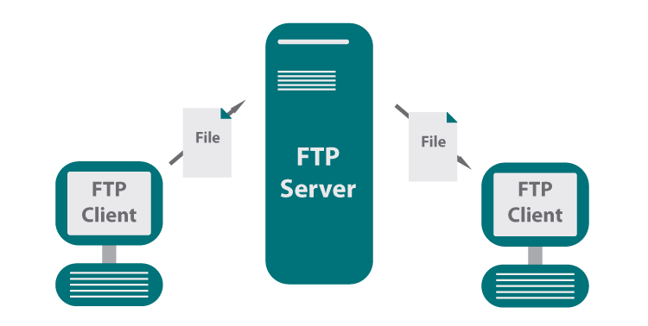



What is FTP?
Application layer protocols: SSH, P2P, FTP, etc.
A protocol used for file download or upload between server and client.
SSH
P2P

Slide 3

How to implement an FTP?
Open computer;
Write code;
Run code;
Is that so?

Slide 4
Socket Programming

Slide 5
What is Socket?
Socket is an API to use internet resources.
Host-local, application-created, OS-controlled interface.
controlled by
application
developer
process
process
socket
socket
Network
resources
Network
resources
controlled by
operating
system
Internet
host or
server
host or
server

Slide 6
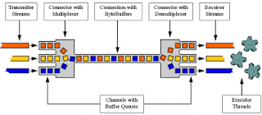
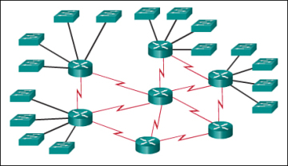
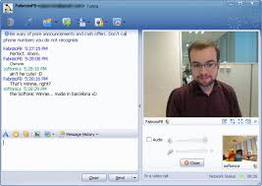


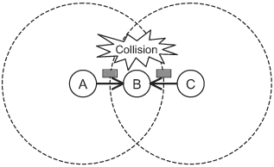
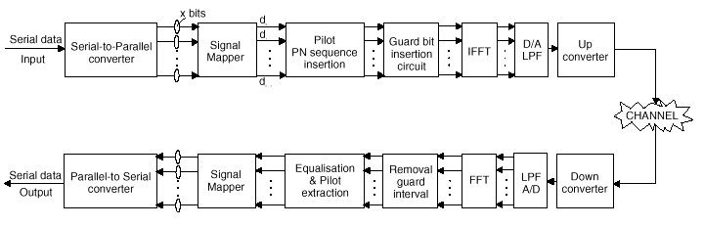
Why do we need socket?
Layering

Slide 7
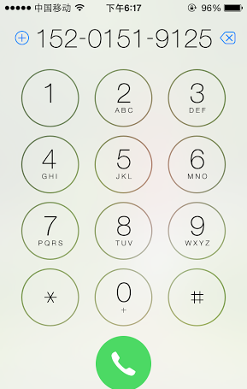
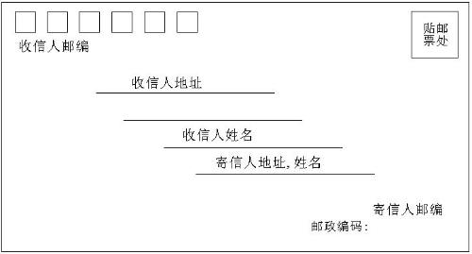
Socket Identification
Mail | Call | Socket
Your Address | Your Phone Num. | Local Socket Address
Her Address | Her Phone Num. | Remote Socket Address
Envelop | Radio | Protocol
Socket?

Slide 8
Address
The address must identify the sender/receiver.
Identification of the host – IP Address
IPv4: 32bit, X.X.X.X, X:8 bit
IPv6: 128bit, Y:Y:Y:Y:Y:Y:Y:Y, Y:16 bit
Identification of the process – Port
0~65535
The five tuples to specify a socket:
(SrcIP, SrcPort, DstIP, DstPort, Protocol)

Slide 9
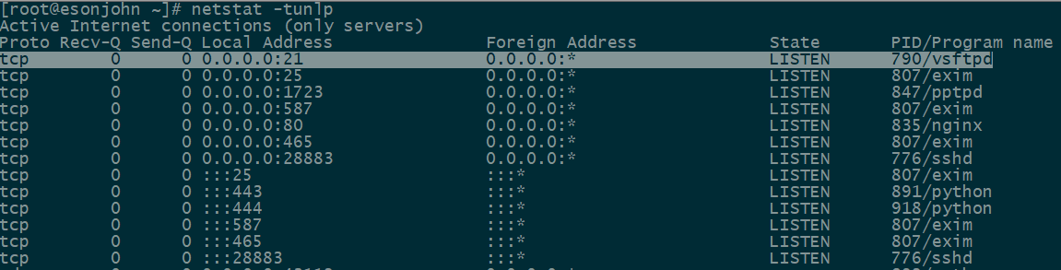
Port Usage
Popular applications have “well-known ports”.
By convention, between 0 and 1023; privileged
E.g., port 80 for HTTP, 25/465 for SMTP, 21 for FTP
For more, refer to Wikipedia.
Custom client gets an unused “ephemeral” port.
By convention, between 1024 and 65535.

Slide 10
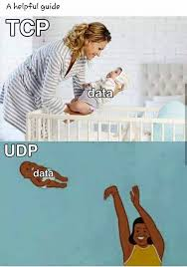
Transport Layer Protocol
Socket at Transport Layer.
UDP
TCP
Fly b*tch

Slide 11
A Preview on UDP
UDP Service: Best-effort transfer of groups of bytes (“datagrams”)
Unreliable (best-effort):
No ack: package loss
No sequence: out-of-order
Connectionless: You have no idea whether the packet is received, unless notified by the receiver.
Lightweight and fast
Multi-media
Routing protocol
DNS

Slide 12
A Preview on TCP
TCP Service: Reliable transfer of byte-stream
Reliable:
Ack
Sequence
Connection maintenance
Build a reliable “pipe” on the unreliable network.

Slide 13
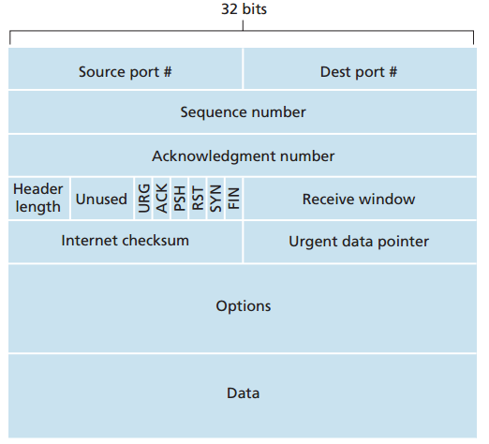
A Preview on TCP
Segment Structure
Seq number, Ack number, Rcv Window for Reliable transmission

Slide 14
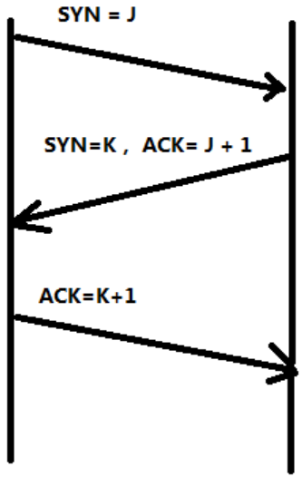


A Preview on TCP
Connection establish: 3-way handshaking
Client notify server with SYN indicator
Server acknowledge client with SYN/ACK indicator
Client acknowledge server with ACK indicator
Client
Server
Hey Alice.
Hi Bob.
Wanna have dinner with me?
Bob
Alice

Slide 15
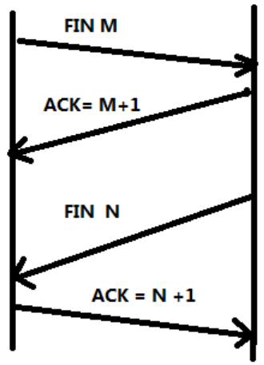
A Preview on TCP
Connection terminate: 4-way handshaking
Client notify server with FIN indicator
Server acknowledge client with ACK indicator
Server notify client with FIN indicator
Client acknowledge server with ACK indicator
Client
Server
I’m leaving.
QAQ
I’m leaving too.
QAQ
Bob
Alice

Slide 16
Socket Programming in C
Client
Server
❍
socket
socket

bind

TCP only
listen
●
Connection Request
■
connect
accept
□
❐
write
read
❑
⬧
read
write
❒
Waiting for next
connection Request
EOF
close
read
close

Slide 17
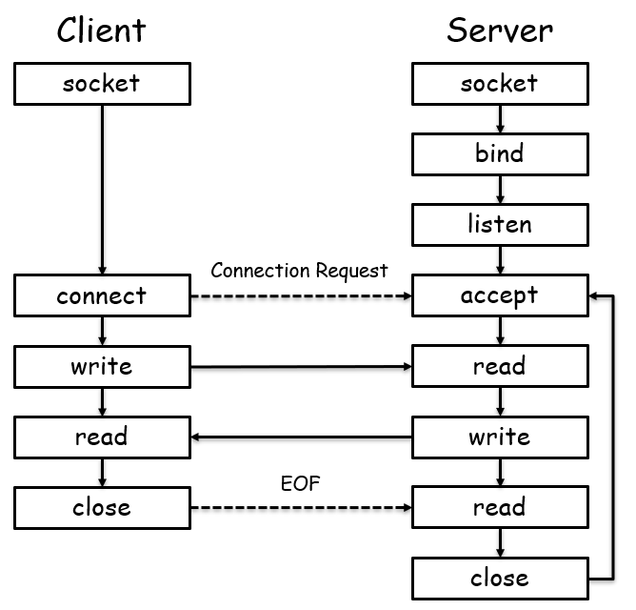
API Functions
Create a socket
int socket(int domain, int type, int protocol)
Domain: ipv4/ipv6
Type: SOCK_STREAM/SOCK_SEQPACKET/…
Protocol: TCP/UDP/…

Slide 18
API Functions
Server listening
Bind some port
int bind (int sockfd, struct sockaddr *my_addr, int addrlen)
sockfd: socket handler
my_addr: local listening address
addrlen: my_addr length
Define how many connections can be pending
int listen(int sockfd, int backlog)
sockfd: socket handler
backlog: maximum connections
Accept a new connection from a client
int accept(int sockfd, struct sockaddr *addr, int *addrlen)
sockfd: socket handler
addr: client address
addrlen: addr length

Slide 19
API Functions
Establish a connection
int connect(int sockfd, struct sockaddr *serv_addr, int addrlen)
sockfd: socket handler
serv_addr: server address
addrlen: serv_addr length

Slide 20
API Functions
For TCP, Send Data
ssize_t write(int sockfd, const void *buf, size_t nbytes);
ssize_t send(int sockfd, const void *buf, size_t nbytes, int flags);
sockfd: socket handler
buf: data buffer
nbytes: write/send data length
flags: block/nonblock/…
For TCP, Receive Data
ssize_t read(int sockfd, void *buff, size_t nbytes);
ssize_t recv(int sockfd, void *buff, size_t nbytes, int flags);
For UDP, use
ssize_t sendto (int sockfd, void *buff, size_t nbytes, int flags, const struct sockaddr *dest_addr, int addrlen);
ssize_t recvfrom (int sockfd, void *buff, size_t nbytes, int flags, const struct sockaddr *src_addr, int addrlen);

Slide 21
API Functions
Byte Ordering
unsigned long int htonl(unsigned long int hostlong)
unsigned short int htons(unsigned short int hostshort)
unsigned long int ntohl(unsigned long int netlong)
unsigned short int ntohs(unsigned short int netshort)
IP Addresses
int inet_aton(const char *cp, struct in_addr *inp)
char *inet_ntoa(struct in_addr in);

Slide 22
Other Tools
How to check if particular port is listening
Windows – use netstat
netstat -an
Linux – use nmap
nmap -sT -O localhost
Status code of bind function indicates port usage
Not knowing what exactly gets transmitted on the wire
Use tcpdump or Ethereal (www.ethereal.com)
Check RFC if in doubt about protocols.
RFC 959

Slide 23
Commands in FTP
USER, PASS
login to server
RETR
download file from server
STOR
upload file to server
PORT, PASV
specify active/passive mode
MKD, CWD, PWD, LIST
manipulate directories on server
...(rfc 959)

Slide 24
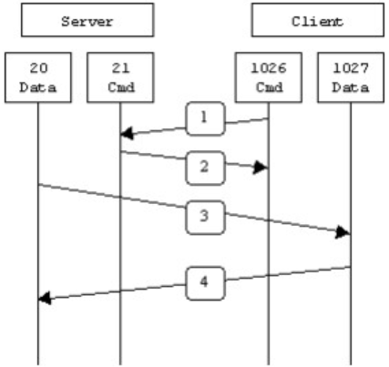
PORT Mode of FTP
PORT(Active Model)
Server monitor default control port 21
Client request control port N1 from OS
Client request data port N2 from OS and notify Server
Server setup connection between local 20 port and client N2 port
Data streams between server 20 port and client N2 port
Data socket
Control socket

Slide 25
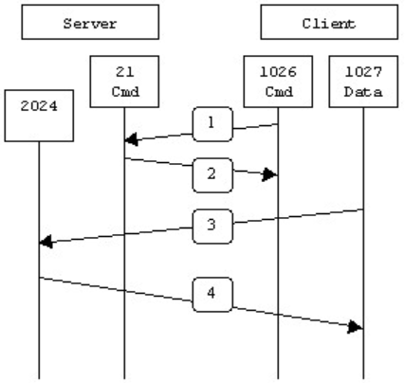
PASV Mode of FTP
PASV(Passive Model)
Server monitor default control port 21
Client request control port N1 from OS
Client request data connection from Server on N1
Server request data port N2 from OS and notify Client
Client request data port N3 from OS
Client setup connection between local port N3 and server port N2
Data streams between server port N2 and client port N3
Data socket
Control socket

Slide 26
PORT vs. PASV
Data socket
Data socket
Control socket
Control socket

Slide 27
Project Description
Goal
Learn to setup communications between PCs with socket.
To be familiar with FTP protocol;
To be familiar with network protocol stack;
Learn to build client/server applications that communicate using sockets.

Slide 28
Task1: UDP Programming
Read the sample code
Choose any language you are familiar with(C, C#, Java, node, Python).
Modify the UDP Server and Client According to the homework guide.
Questions:
How to write a chat programming (two clients chat with each other) with UDP?

Slide 29
Task2: Implementing FTP Server
Must use the Berkeley Socket API (Linux) and write your server in C;
Must serve files from a designated directory on your system to clients making requests on a designated TCP port;
Must handle USER, PASS, RETR, STOR, QUIT, SYST, TYPE, PORT, PASV, MKD, CWD, PWD, LIST, RMD, RNFR, RNTO commands;
Handling invalid input reasonably and generating defensible error codes;

Slide 30
Task2: Implementing FTP Server
May not use any libraries containing code specifically designed to implement FTP functionality (coding at socket level);
Support integral large file transmission;
Support connections from multiple clients;
Optional
Resume transmission after connection terminated;
File transmission without blocking the server;

Slide 31
Task3: Implementing FTP Client
You can write your client in your favorite programming language;
Must handle USER, PASS, RETR, STOR, QUIT, SYST, TYPE, PORT, PASV, MKD, CWD, PWD, LIST, RMD, RNFR, RNTO commands;
Able to log in a provided commercial FTP server and download/upload files;

Slide 32
Task3: Implementing FTP Client
Friendly GUI;
Support integral large file transmission;
Optional
Resume transmission after connection terminated;
File transmission without blocking the GUI;

Slide 33
Some Important Issues
Grading
UDP Programming (10%)
Implementation of FTP (70%+10%)
Server (40%)
Client (30%)
Optional (10%)
Project Report (20%)
Individual work.

Slide 34
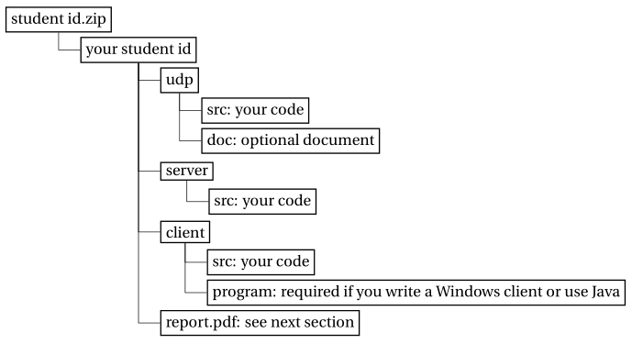
Some Important Issues
Submission
Source code for udp, server/client;
Executable file and how to run it;
Report: no longer than THREE pages.
Files are to be organized as follows:
Evaluation
Auto-grading program for FTP server.
Face-to-face check for FTP client.

Slide 35
Some Important Issues
Important Date
Start up: today (2021.9.29.)
Due date:
3.5 weeks later (2021.10.24.)

Slide 36
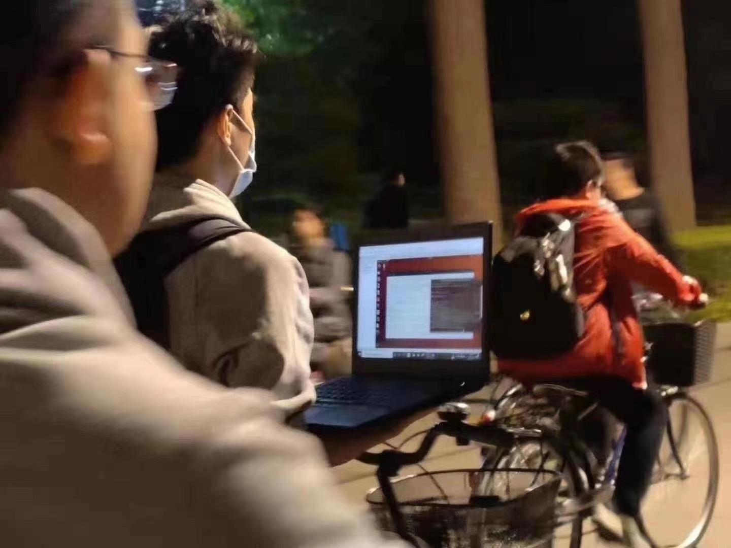
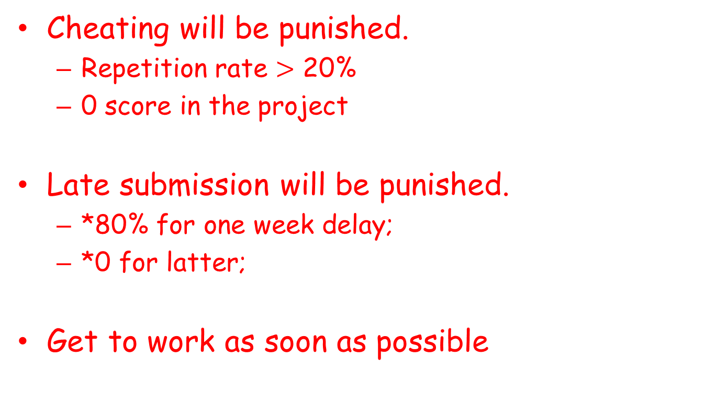
Some Important Issues
Cheating will be punished.
Repetition rate $>$ 20%
0 score in the project
Late submission will be punished.
*80% for one week delay;
*0 for latter;
Get to work as soon as possible

Slide 37
Problems Emerged
Improper use of control/data socket(list, pwd)
Illegal design of command (PORT/PASV)
Fails to connect to standard FTP server
Follow RFC protocol
Security Issue
Fails to check username & password
cd ..
String Issue (\0)
Exceptions
Socket exception
I/O exception

Slide 38
How to implement an FTP?
Read RFC959 document;
Coding ON YOUR OWN;
Debugging;

Slide 39
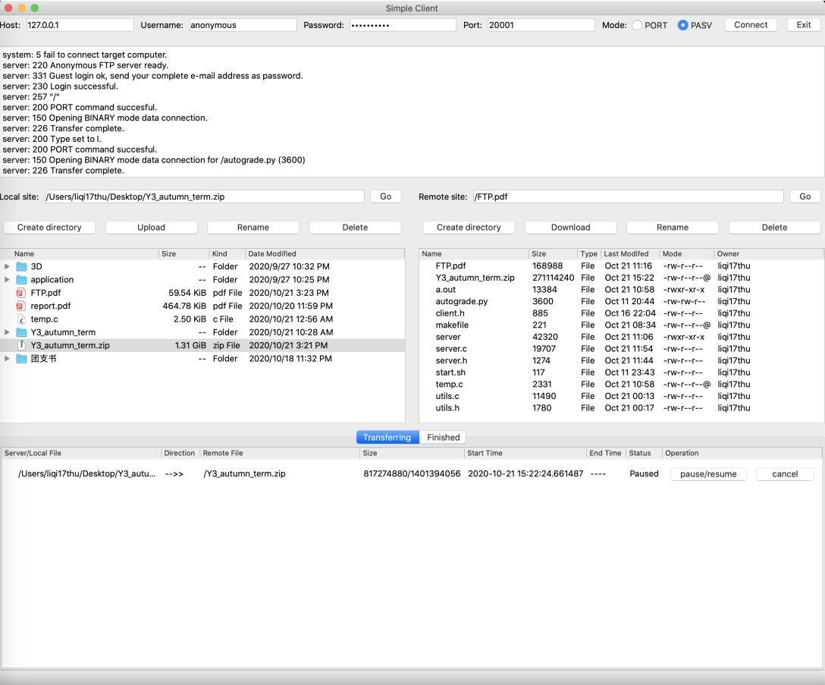
Previous Outstanding Project
Student A

Slide 40
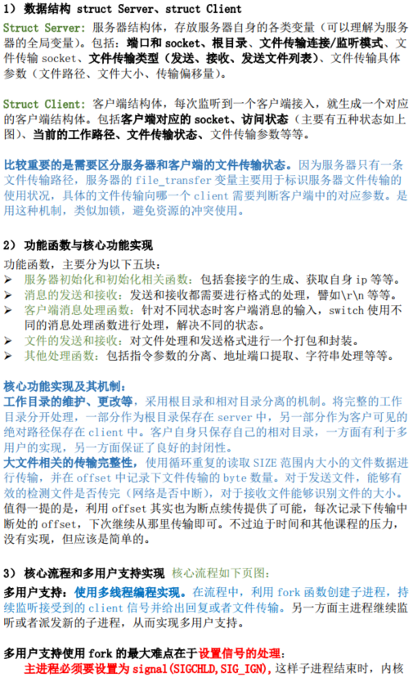
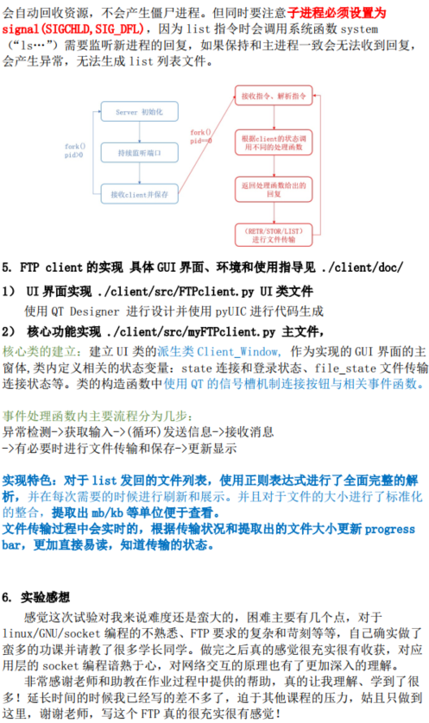
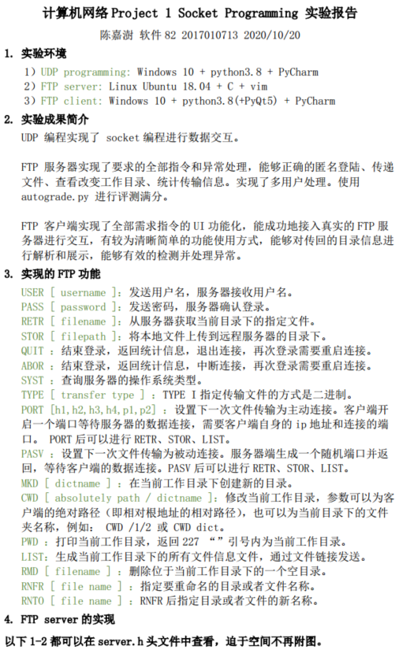
Previous Outstanding Project
Student B

Slide 41
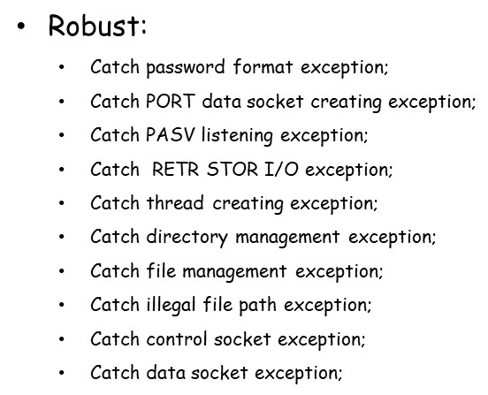
Previous Outstanding Project
Student C
Handle the following exceptions:

Slide 42
Happy National Day
Good luck

